Slide 1
CEIS295 Module 3
Speed Test for ArrayList Data Structure

Slide 2
Rubric
Activity | Requirement(s) | Points
Develop Code to Use Objects with the ACD | Call.py Code | 20
Develop Code to Simulate ACD | AutomaticCallDistributor.py code | 20
Screenshot to Demonstrate Working Application | Screenshot of running application showing your name and the current date | 10

Slide 3
Call.py Python Code
Code:
#Name: Kyrenia Ailen Andrade Avila
#Date: 07/23/2022
from time import strftime #used for the current date and time
class Call:
def __init__(self, client_id=0, client_name="Unknown", client_phone="Unknown"):
self.client_id = client_id
self.client_name = client_name
self.client_phone = client_phone
self.call_date = strftime("%m/%d/%Y")
self.call_time = strftime("%H:%M")
# __str__() method is automatically called when you print the object
def __str__(self):
return str(self.client_id) + ", " + self.client_name + \
"\n\tPhone: " + self.client_phone + \
"\tDate/Time: " + self.call_date + " @ " + self.call_time
Paste your Call.py Python code in the box on the right side.
Include the following attributes and behaviors:
Attributes
call_id
customer_name
customer_phone
call_date
call_time
Behaviors
__str__

Slide 4
AutomaticCallDistributor.py Python Code
Code:
#Name: Kyrenia Ailen Andrade Avila
#Date: 07/23/2022
from Queue import Queue
from Call import Call
from datetime import date
import time # use to pause the application
import random # use to generate random numbers
#display author's name and date in the output
print("Name:", "Kyrenia Ailen Andrade Avila")
print("Date:", date.today())
print()
#create a list
calls = []
#read a call records into the list
input_file_name = "CallsData.csv"
with open(input_file_name) as infile:
for line in infile:
#split the line based on the commas
s = line.split(',')
client_id = int(s[0])
client_name = s[1]
client_phone = s[2]
#create a Call object based on the data from the line
a_call = Call(client_id, client_name, client_phone)
#add the Call object to the list
calls.append(a_call)
#Queue object for our calls
calls_waiting = Queue()
call_number = 0
#how long is the simulation
seconds = int(input("How many seconds do you want to simulate? "))
#run simulations for the given number of seconds
for i in range(seconds):
print("-" * 40)
time.sleep(2) #pause the application for 2 seconds
random_event = random.randint(1, 3) #random number
#do event based on the random number generated
if random_event == 1:
print("Call received. Caller added to the queue.")
calls_waiting.enqueue(calls[call_number])
call_number += 1 #set up the next call
print("\tNumber of calls waiting in queue:", calls_waiting.get_length())
elif random_event == 2:
print("Call sent to representative for service.")
if calls_waiting.get_length() > 0:
print("Caller information:")
print(calls_waiting.dequeue())
else:
print("The call waiting queue is empty:")
print("\tNumber os calls waiting in queue:", calls_waiting.get_length())
else:
print("Nothing happened during this second in time.")
print("\tNumber os calls waiting in queue:", calls_waiting.get_length())
print ("\nThe 'Automatic Call Distributor' simulation has completed.")
Paste your Python code. Include the following processes:
Simulation of ADT
Ask user how many times to repeat
On each loop:
Randomly generate a number from 1 to 3
If 1, add call to queue
If 2, remove call from queue
If 3, do nothing

Slide 5
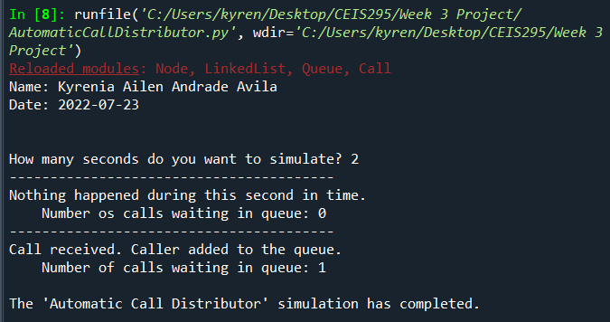
Screenshot of Running Code
Run your AutomaticCallDistributor.py code and take a screenshot of the output. The output screenshot must show your name and the date to be accepted.
Please note. We are looking to avoid plagiarism. As a result, if the running code does not show your name and the current date, then this Course Project will be given a zero until you submit a PowerPoint that shows your name and the current date in the output screenshot.

